Slide 1
Key elements of applications
Università di Modena e Reggio Emilia
Prof. Nicola Bicocchi (nicola.bicocchi@unimore.it)

Slide 2
Activity

Slide 3
Introduction
In a mobile application a user can start interacting with it in a non-deterministic way.
Think about a single app in our smartphone. How many ways can we access it? opening it directly or through other apps that call it.
The activities has progressed to facilitate this paradigm, when one app calls another, the calling app calls an activity in the other app rather than calling it back as an atomic whole.

Slide 4
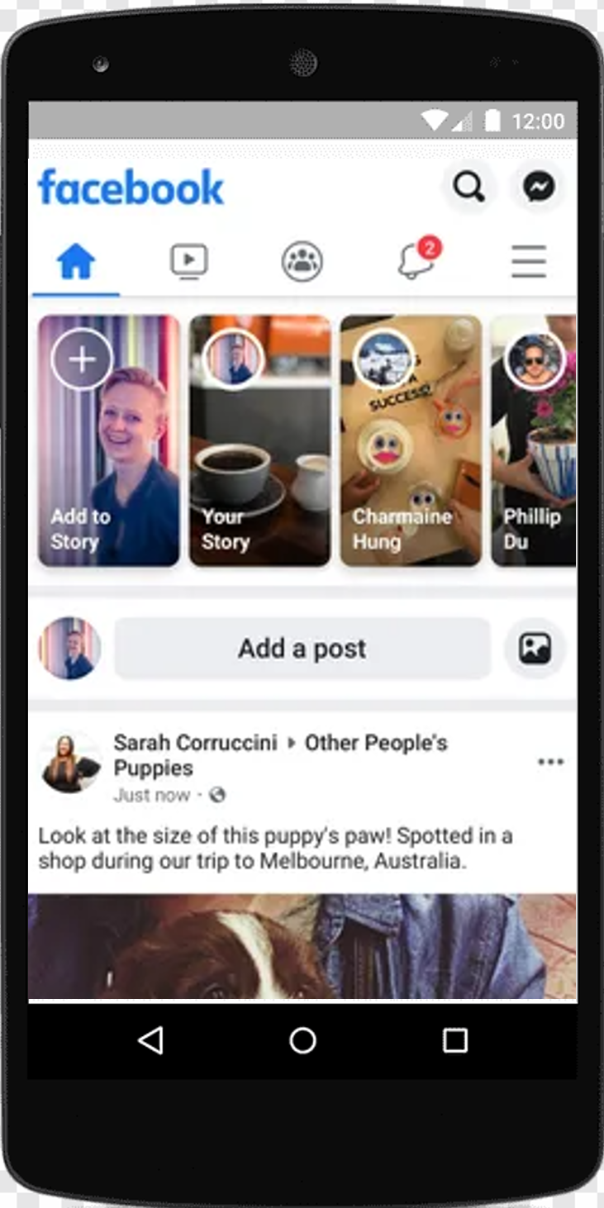
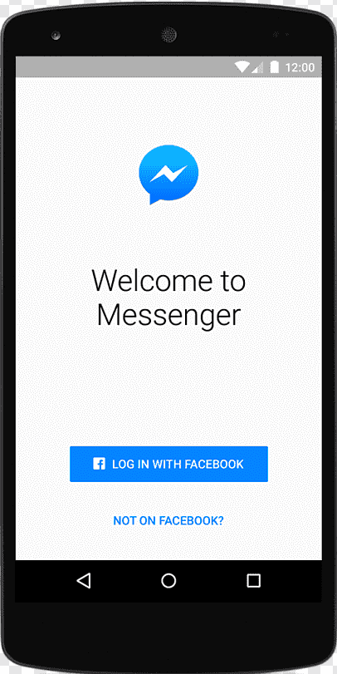
What is it?
The activity is an entry point for the interaction of an app with the user. One app consists of multiple screens which each of them is represented by one Activity. So, switch to a screen to another means go to another activity. If we wanted to make another parallelism, we can compare an Activity to a Java Swing frame.

Slide 5
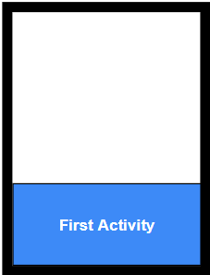
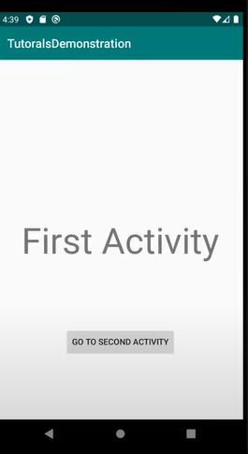
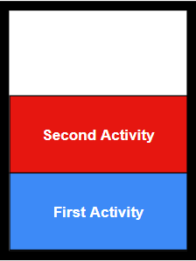
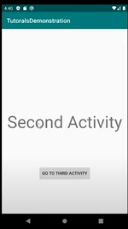
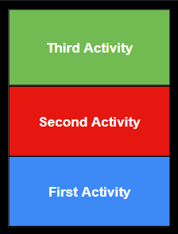
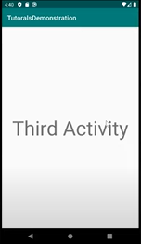
Stack of activity
When the current activity starts another, the new activity is pushed on the top of the stack and takes focus. The previous activity remains in the stack ,but is stopped. When an activity stops, the system retains the current state of its user interface.
When the user performs the back action, the current activity is popped from the top of the stack (the activity is destroyed) and the previous activity resumes (the previous state of its UI is restored). Activities in the stack are never rearranged, only pushed and popped from the stack—pushed onto the stack when started by the current activity and popped off when the user leaves it using the Back button or gesture

Slide 6
Activity Lifecycle
User interaction with our application means that instances of Activity pass through different states of their lifecycle
Ex: user open app, switch to another app, return to application etc..
Activity class provides callbacks that allow an activity to know that a state has changed. We can implement within these methods how the activity should behave following a change in status. Good implementation of life cycle callbacks is useful to avoid the following problems:
crash if the user switches to another app or receives a phone call
consume valuable resources when the user does not use the app
abnormal shutdown or data loss when the screen is rotated

Slide 7
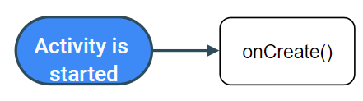
onCreate()
onCreate(): first function called when one Activity start, inside this method we insatiate our object and initialize those variables needed when the activity just starts. Once the Activity is created it enters the "created" state. The code inside should only be executed once for the entire life of the task. (only when the application starts).

Slide 8
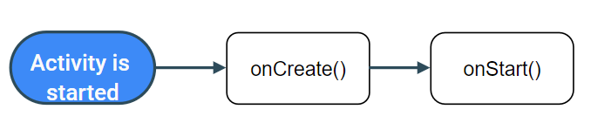
onStart()
onStart(): the activity becomes visible to the user the onStart function is called, while the app prepares for the activity to enter the foreground and become interactive. When the activity moves to the initiated state, any conscious component of the activity life cycle will receive the ON_START event.
The onstart() method is completed very quickly and, as with the Created state, the activity does not remain resident in the Initiated state. Once this callback is finished, the task enters the Resumed state and the system invokes the onResume() method.

Slide 9
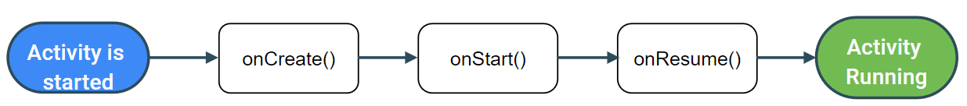
onResume()
onResume: is called when the Activity starts to interact with the user and when the activity is in this state, we can be sure that our Activity is fully running.
The app stays in this state until something happens to take focus away from the app. Such an event might be, for instance, receiving a phone call, the user’s navigating to another activity, or the device screen’s turning off.

Slide 10
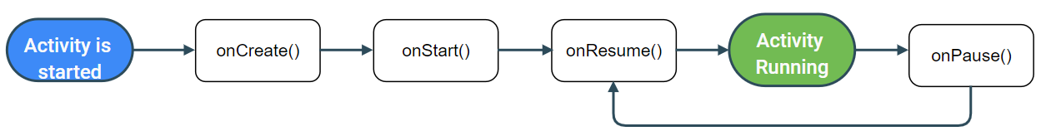
onPause()
onPause(): is called when activity loses foreground state, is a method use to pause or adjust operations that should not continue while the Activity is in the Paused state, and we expect to resume shortly.
If an Activity goes into the background (the user switches to another task) the onPause method is called and when it is returned to the foreground the activity will not be recreated, but the onResume method will be used to run it exactly in the previous state.

Slide 11
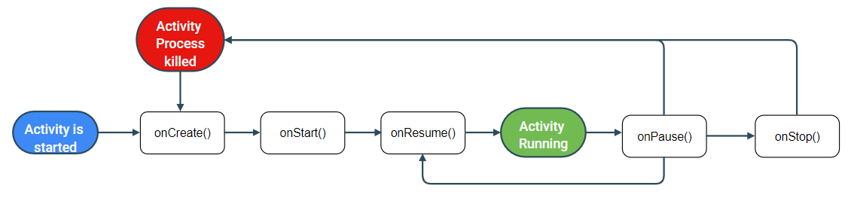
onStop()
onStop: is called when the activity is no longer visible to the user because a new activity is started or is been destroyed by the system. Provides, in the absence of memory, to eliminate the pending Activities not necessary.

Slide 12
Note
if Apps with higher priority needs memory can happened that the system will kill our app and the life cycle will start with onCreate() again if the user navigates back to our activity. In that case we cannot just jump right into onResume() or onStart() but we have to recreate whole the activity.
since the onPause() execution is very short, and not necessarily afford enough time to perform saving operations. For this reason, we should not use onPause() to save application or user data, make network calls, or perform database transactions; this work may not be completed before the method is completed.
If we need that your app continue to do update while the user interact with another Activity, using onStop() instead onPause() ensures that UI-related work continues, even when the user is viewing your activity in multi-window mode.
we should also use onStop() to perform relatively CPU-intensive shutdown operations. For example, if you can't find a more opportune time to save information to a database, you might do so during onStop().

Slide 13
Note
When your activity enters the Stopped state, the Activity object is kept resident in memory: It maintains all state and member information but is not attached to the window manager.
When the activity resumes, the activity recalls this information. You don’t need to re-initialize components that were created during any of the callback methods leading up to the Resumed state

Slide 14
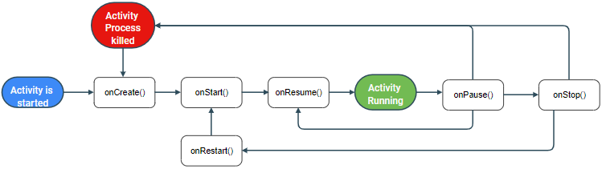
onRestart()
onRestart: Called after your activity has been stopped, prior to it being started again.

Slide 15
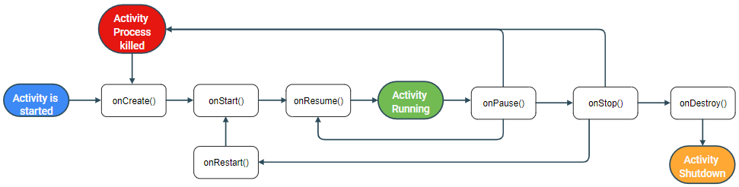
onDestroy()
onDestroy(): is called before the activity is destroyed. The system invokes this callback either because:
the activity is finishing (due to the user completely dismissing the activity or due to finish() being called on the activity)
the system is temporarily destroying the activity due to a configuration change (such as device rotation or multi-window mode)

Slide 16
Code
Each java class in our project represent a single activity, Android studio auto-generate for us the main class called MainActivity which is the first activity showed when we run the emulator.
public class MainActivity extends AppCompatActivity { @Override protected void onCreate(Bundle savedInstanceState) { super.onCreate(savedInstanceState); setContentView(R.layout.activity_main); } }

Slide 17
Code
Unlike programming paradigms in which apps are launched with a main() method, the Android system launch code in an activity instance by invoking specific callback methods that correspond to specific stages of its lifecycle.
public class MainActivity extends AppCompatActivity { @Override protected void onCreate(Bundle savedInstanceState) { super.onCreate(savedInstanceState); setContentView(R.layout.activity_main); } }
savedInstanceState: object used to save the previous instance. If onCreate() is the first time called, this object is null.
The Bundle class is used to store task data whenever previous conditions occur in the app for example when we rotate our device.
setContentView(int):define our UI with a layout resource contained in the path res/layout/activity_main

Slide 18
Intent

Slide 19
Introducion
An intent is an abstract description of an operation to be performed. Is a sort of form of messaging managed by the operating system with which a component requires the execution of an action by another component. This useful tool can be used in three typical scenarios:
Start an Activity
Start one Service
Send a broadcast message that can be received by each application.

Slide 20
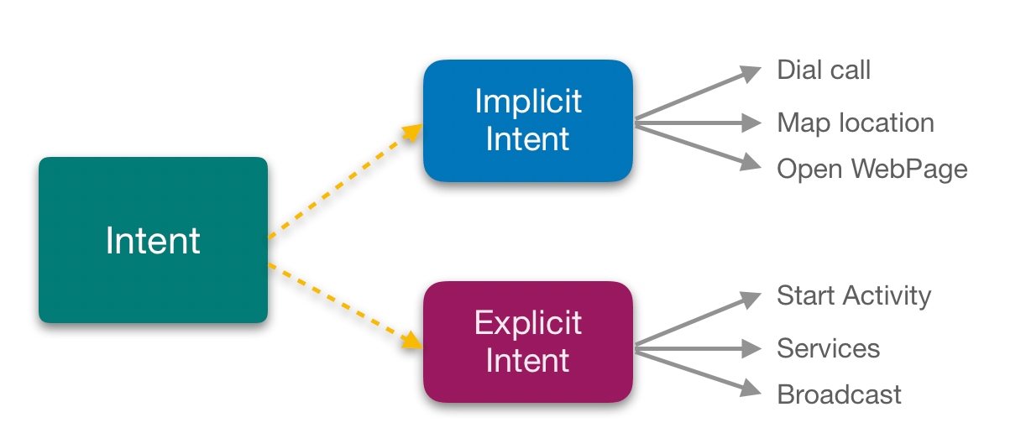
Introduction
An Intent provides a facility for performing late runtime binding between the code in different applications. Its most significant use is in the launching of activities, where it can be thought of as the glue between activities. We can divide intent in two distinct category:

Slide 21
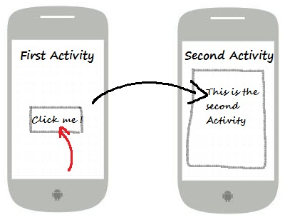
Explicit intent
Typically we use an explicit intent to start a component in our app, because we know the class name of the activity or service we want to start. For example, we might start a new activity within our app in response to a user action, or start a service to download a file in the background.

Slide 22
Declaration
Intent i=new (Context c,Class d)
startActivity(i);
Context: is an interface to global information about an application environment. This is an abstract class whose implementation is provided by the Android system. It allows access to application-specific resources and classes.
Class: is the Activity class that we want to call to perform the action, is necessary know it.

Slide 23
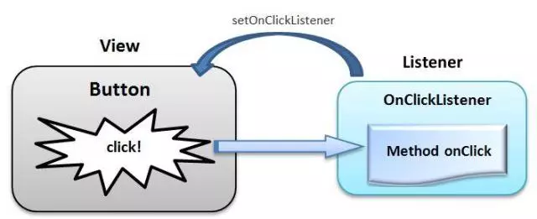
Button
To change Activity is not enough to use an intent to perform this operation, we need a Button and understand how should behave following an event. As we saw on Java Swing, we can handle by a listener.

Slide 24
1-way:Java & XML
Inside XML file where button is defined, we add an attribute that tells our XML code: when the button is clicked doSomething should happened.
<Button android:id="@+id/button" android:layout_width="160dp" android:layout_height="89dp" android:text=“Click" android:onClick=“doSomething"/>

Slide 25
1-way:Java & XML
doSomething is a method inside Activity class that takes a View argument (a button Is a View subclass),and inside we declare what behavior our button should have. In our case we declare an Intent
public void onClick(View view) { Intent intent=new Intent(this,NameOfOtherActivity.class); startActivity(intent); }
Issue: Android always try to separate code with graphics, this is an easy way to implement a clickListener but create a bind that between two worlds, if we create a new method do handle the button o change the name and forgett do appropriate changes the app will crush.

Slide 26
2-way: OnClickListener
If Activity needs to handle click event they can implement OnClickListener interface, override onClick method without having to add anything to the XML file respecting the separation practice of Android.
public class MainActivity extends AppCompatActivity implements OnClickListener { @Override protected void onCreate(Bundle savedInstanceState) { super.onCreate(savedInstanceState); setContentView(R.layout.activity_main); } @Override public void onClick(View view) { } }

Slide 27
2-way: OnClickListener
public class MainActivity extends AppCompatActivity implements OnClickListener { @Override protected void onCreate(Bundle savedInstanceState) { super.onCreate(savedInstanceState); setContentView(R.layout.activity_main);
Button button=(Button)findViewById(R.id.button);
button.setOnClickListener(this); } @Override public void onClick(View view) { Intent intent=new Intent(this,SecondActivity.class); startActivity(intent); } }
<Button android:id="@+id/button" android:layout_width="wrap_content" android:layout_height="wrap_content" android:text="Button" />
Inside onCreate method we instantiate a Button and get a reference of XML object contained on resource id named “button”. After we set the clickListener that will be our Activity Class.

Slide 28
2-way:multiple Button
public class MainActivity extends AppCompatActivity implements OnClickListener { @Override protected void onCreate(Bundle savedInstanceState) { super.onCreate(savedInstanceState); setContentView(R.layout.activity_main);
Button btn1=(Button)findViewById(R.id.btn1);
btn2.setOnClickListener(this);
Button btn2=(Button)findViewById(R.id.btn2);
btn2.setOnClickListener(this); } @Override public void onClick(View view) {
…
} }
@Override public void onClick(View view) { if(view.getId()==R.id.btn1) { Intent intent=new Intent(this,SecondActivity.class); startActivity(intent); } if(view.getId()==R.id.btn2) { Intent intent=new Intent(this,ThirdActivity.class); startActivity(intent); } }
If Activity has more than one Button we can use the same method and depending on the case, change the behavior according to which button is pressed

Slide 29
2-way:Issue
If an activity contains several button, the addition of other produces the addition of lines to define the button and the continuous modification of the onclick method
public void onClick(View view) { if(view.getId()==R.id.btn1) { Intent intent=new Intent(this,SecondActivity.class); startActivity(intent); } if(view.getId()==R.id.btn2) { Intent intent=new Intent(this,ThirdActivity.class); startActivity(intent); }
if(view.getId()==R.id.btn3) { Intent intent=new Intent(this, FourthActivity.class); startActivity(intent); }
..
if(view.getId()==R.id.btnN) { Intent intent=new Intent(this,NActivity.class); startActivity(intent); }
}
Button btn1=(Button)findViewById(R.id.btn1);
btn2.setOnClickListener(this);
Button btn2=(Button)findViewById(R.id.btn2); btn2.setOnClickListener(this);
Button btn3=(Button)findViewById(R.id.btn3);
btn3.setOnClickListener(this);
Button btn4=(Button)findViewById(R.id.btn4);
btn4.setOnClickListener(this); …
Button btnN=(Button)findViewById(R.id.btnN);
btnN.setOnClickListener(this);

Slide 30
3-way:Anonimous Class
Typical Android implementation of a click listener involves the use of anonymous classes, instead implementing onClickListener interface, we can use a HOC class for only one button and override onClick method.
protected void onCreate(Bundle savedInstanceState) { super.onCreate(savedInstanceState); setContentView(R.layout.activity_main);
Button btn=(Button)findViewById(R.id.button);
btn.setOnClickListener(new View.OnClickListener(){ @Override public void onClick(View view) { Intent intent= new Intent(MainActivity.this,SecondActivity.class); startActivity(intent); } });
}

Slide 31
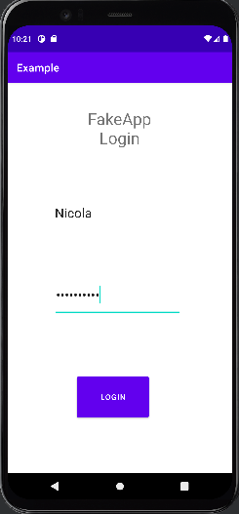
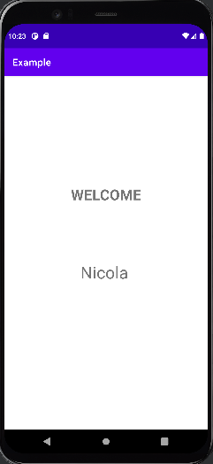
Example
Now that we are aware of these considerations, let’s take a real case where we want following a proper login go to the main screen of our app
Note: for this example, we use a Class that simulate Db where our credentials are stored
public class FakeDb { private final String username="Nicola"; private final String email="nbicocchi@unimore.it"; private final String password="Nicola"; public String getUsername() { return username; } public String getEmail() { return email; } public String getPassword() { return password; } }

Slide 32
Implementation
public class LoginActivity extends AppCompatActivity { @Override protected void onCreate(Bundle savedInstanceState) { super.onCreate(savedInstanceState); setContentView(R.layout.activity_login); EditText text_user= findViewById(R.id.usernameText); EditText text_password= findViewById(R.id.passwordText); Button home=findViewById(R.id.loginButton); home.setOnClickListener(new View.OnClickListener() { @Override public void onClick(View view) { FakeDb fakeDb=new FakeDb(); String username=String.valueOf(text_user.getText()); String password=String.valueOf(text_password.getText()); if(username.equals(fakeDb.getUsername()) || username.equals(fakeDb.getEmail()) && password.equals(fakeDb.getPassword())) { Intent intent = new Intent(LoginActivity.this, HomeActivity.class); intent.putExtra("username", fakeDb.getUsername()); startActivity(intent); } } }); }}

Slide 33
Implementation
public class HomeActivity extends AppCompatActivity { @Override protected void onCreate(Bundle savedInstanceState) { super.onCreate(savedInstanceState); setContentView(R.layout.activity_home);
//initialize intent from LoginActivity Intent intent=getIntent(); //recover string from intent String content=intent.getStringExtra("username"); TextView name=findViewById(R.id.name);
//to show username on screen name.setText(content); }}

Slide 34
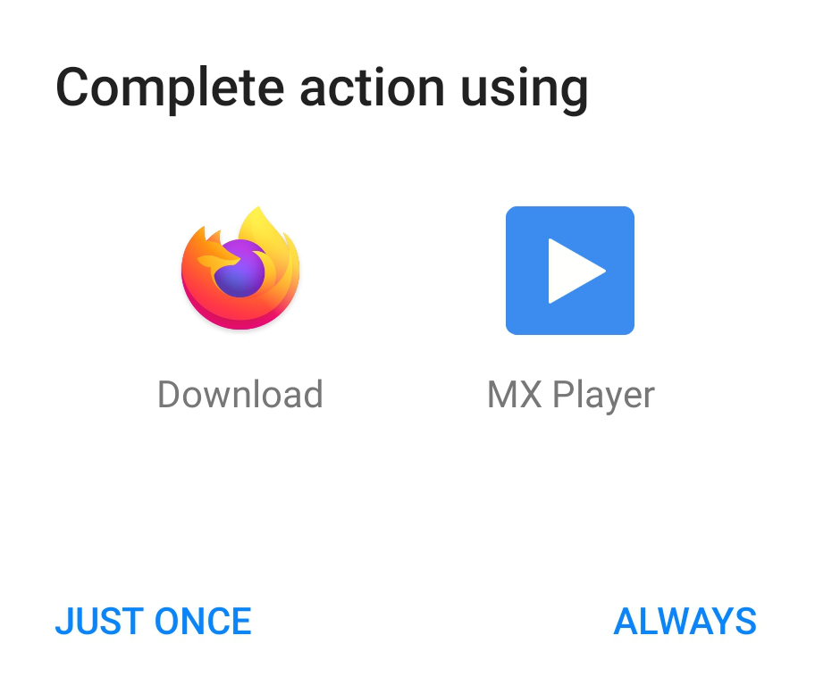

Implicit Intent
Tell what action you want to perform without caring about who can perform it .When we don’t declare which, specific component must be activated, but only what action must be carried out we use implicit intent .

Slide 35
Intent Structure
Both type of intent are composed by:
Action: define what we want to do:
Intent.ACTION_VIEW: to view Internal or External Device Data
Intent.ACTION_CALL: to dial a phone number
Intent.ACTION_DIAL: to call a number
Intent.ACTION_EDIT: to edit Data
more actions
Data: what type of data we want to work with, for example a record of people in the contact database, expressed as Uri.
URI: Uniform Resource Identifier (URI) is a sequence of characters that universally and uniquely identifies a resource

Slide 36
Intent Structure
And additionally, by:
Extras: what additional information we need to provide (key/value pairs) . Can be used to provide extended information to the component.
intent.putExtra("username",”Jhon”);
Category: Gives additional information about the action to execute ,for example, CATEGORY_LAUNCHER means it should appear in the Launcher as a top-level application. more categories

Slide 37
Declaration
Since explicit intent does not need to use these elements to be used, on the other hand implicit intent needs it and a dedicated constructor is used.
Intent intent=new Intent(Action,Data)
Action is required, instead Data is optional.
Ex: Intent intent=new Intent(Intent.ACTION_SEND);
startActivity(intent);

Slide 38
Intent Filter
Describe what action, data and categories a component can handle, defined mostly inside the manifest but may be dynamically registered in code. for each activity, services we want them to manage implicit intent we must declare intent filter.
<activity android:name=".MainActivity" android:exported="true"> <intent-filter> <action android:name="android.intent.action.MAIN" /> <category android:name="android.intent.category.LAUNCHER" /> </intent-filter> </activity>

Slide 39
Intent Resolution
When intent is fully declared is sent to the PackageManager: Class for retrieving various kinds of information related to the application packages that are currently installed on the device
1
Action
PackageManager
Category
Data

Slide 40
Intent Resolution
PackageManager compare data inside the intent and the list of activity available, his purpose is to find which who can perform intent’s action. After this comparison we can have three results:
2
Package
Manager
1
Action
Category
Data
Action
Activity

Slide 41
Intent Resolution
1
2
3
Package
Manager
Action
No activity is found to perform the action
One Activity is found and is directly launched
One or more Activity are found, the PackageManager show the list of activities found.
Category
Data
Action
Activity

Slide 42
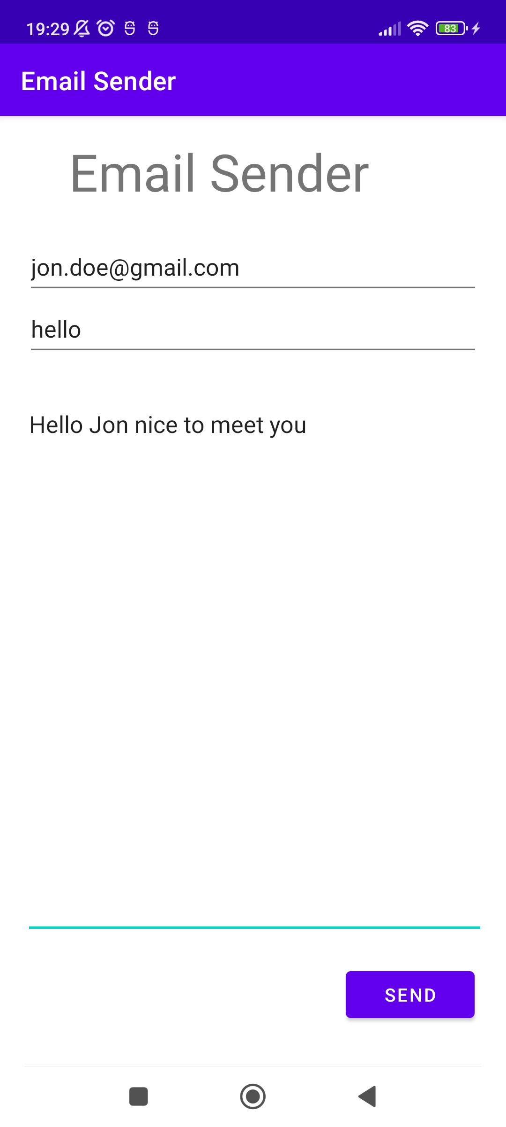
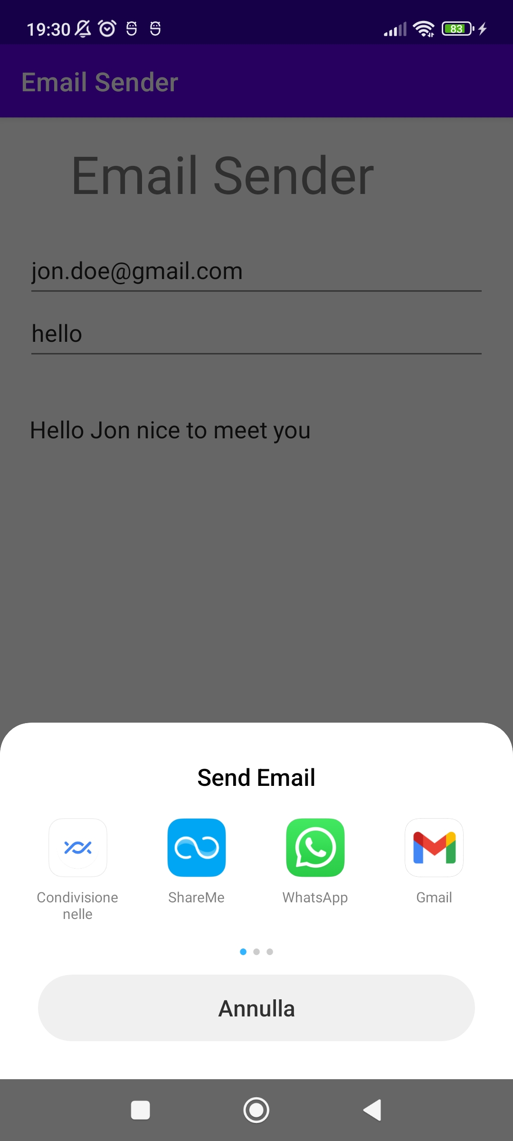
Example
Now let’s try to create an activity that can send an email, we will execute a Intent.ACTION_SEND since some apps may any app that can perform the action, our app will crush.
To avoid it we add a Chooser intent that allows the user to choose which app in his device will perform the operation

Slide 43
Code
public class MainActivity extends AppCompatActivity {
EditText rec,subject,message; Button btn; @Override protected void onCreate(Bundle savedInstanceState) { super.onCreate(savedInstanceState); setContentView(R.layout.activity_main);
rec=indViewById(R.id.textTo); //email’s receivers subject=findViewById(R.id.textSubject); // email’s subject message=findViewById(R.id.textMessage); //email’s body btn=findViewById(R.id.buttonSend); btn.setOnClickListener(new View.OnClickListener() { @Override public void onClick(View view) { Intent intent = new Intent(Intent.ACTION_SEND); intent.setData(Uri.parse("mailto:")); String[] receivers=String.valueOf(rec.getText()).split(" ");
//add extra data for the app performing intent action intent.putExtra(Intent.EXTRA_EMAIL,receivers); intent.putExtra(Intent.EXTRA_SUBJECT,String.valueOf(subject.getText())); intent.putExtra(Intent.EXTRA_TEXT,message.getText()); //specify MIME type for Email intent.setType("message/rfc822");
//create Chooser Intent chooser=Intent.createChooser(intent,"Send Email"); startActivity(chooser); startActivity(intent); } }); }}

Slide 44
Fragment

Slide 45
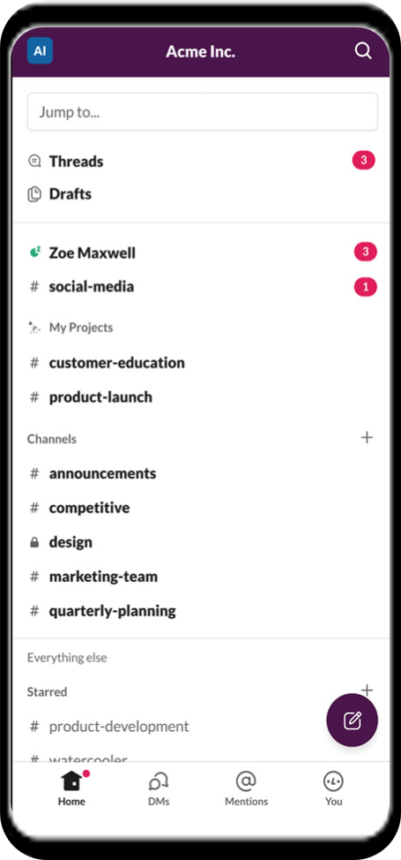
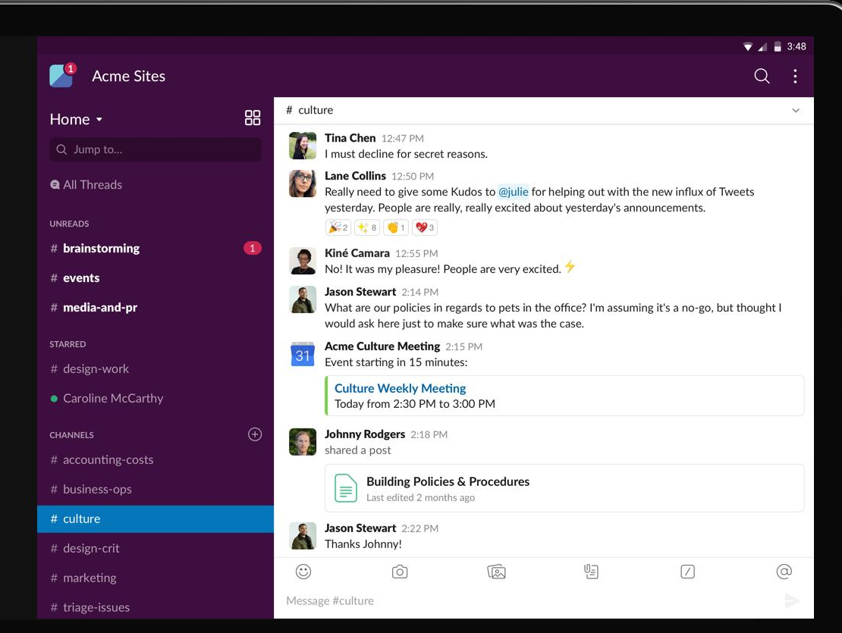
Motivation
One of the great things about Android development is that we can put the exact same app on different devices in terms of screen’s size or processors and they will run in the exact same way. But doesn’t mean they have to look necessary the same way.

Slide 46
Introducing: Fragment
A Fragment represents a reusable components or subactivities used to control part of a screen and can be reused between them. Thinking of java Swing, a fragment is like a panel hosted by a frame.
Defines and manages its own layout, has its own lifecycle, and can handle its own input events.
Fragments cannot live on their own: they must be hosted by an activity or another fragment.
The fragment’s view hierarchy becomes part of, or attaches to, the host’s view hierarchy.
Like an activity, a fragment has a layout associated

Slide 47
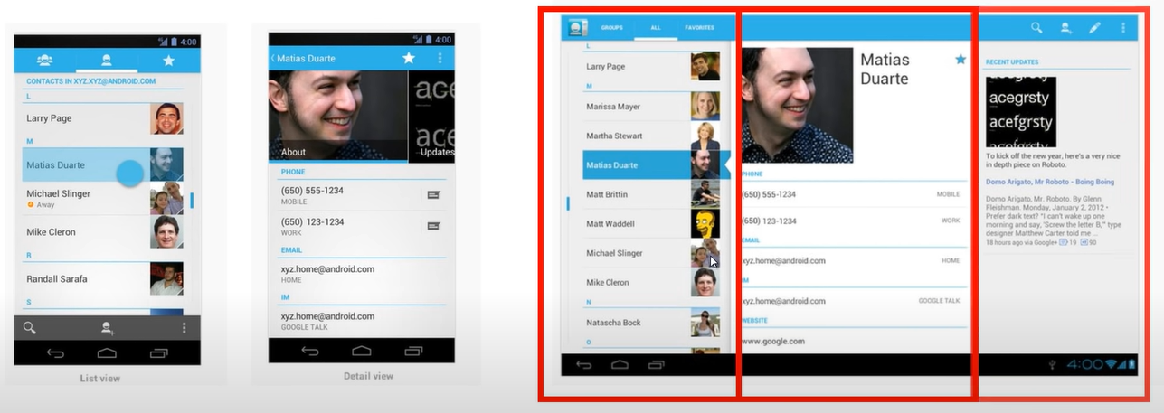
Why use it?
To Combine multiple fragments in a single activity and reuse the same fragment across sever Activities
Make better use of larger screen space on tablets
support different layout portrait and landscape model
Make flexible user interfaces across different screen sizes like Fixed/Scrolling/Swipe tab displays and Dialog boxes

Slide 48
Fragment Object States
A fragment object exists in different state:
Fragment
As a Java Object
fragment object exist as Java object, but it has not been link with the activity inside where it lives

Slide 49
Fragment Object States
Fragment
As a Java Object
Attached to an Activity
Once attach the fragment to an activity, it exists as Java Object and attached to an activity but at this point the fragment may or may not be visible to the user.

Slide 50
Fragment Object States
Fragment
As a Java Object
Attached to an Activity
Finally, when a java object is fully initialized and attached became visible to the user
Visible UI on the Screen

Slide 51
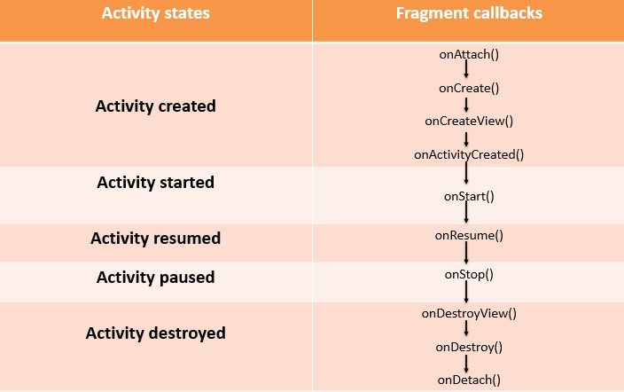
Activity vs Fragment
As we say for the activity, fragments have their own callback, what really change is when this method are called in the activity cycle.
onAttach(Activity): This happens when the fragment is associated with an activity.
onCreate(Bundle) :very similar to the activity’s onCreate() method. It can be used to do the initial setup of the fragment.
onCreateView(LayoutInflater, ViewGroup, Bundle): is where we link the layout file of a fragment to its object,fragments use a layout inflater to create their view at this stage.
onActivityCreated(Bundle): return and Id when onCreate() method of the activity has completed, that means the UI is initialized and ready to use and we can now access and modify UI elements of fragment.

Slide 52
Activity vs Fragment
onStart(): called when the fragment is about to become visible.
onResume(): Called when the fragment is visible and actively running.
onPause(): Called when the fragment is no longer interacting with the user.
onStop(): Called when the fragment is no longer visible to the user.
onDestroyView(): is called when fragment view is unlinked form Java object, gives the fragment the chance to clear away any resources that were associated with its view.
onDestroy(): In this method, the fragment can clear away any other resources it created.
onDetach() When the fragment finally loses contact with the activity. After that is not associated with anything.

Slide 53
Create a Fragment

Slide 54
Fragment Manager
Is an object responsible for maintaining references to all the fragments present inside the activity.
using findFragmentById() or findFragmentByTag() we get reference to a particular Fragment.
Every Activity has it own Fragment Manager accessible through getFragmentManager().

Slide 55
Fragment Transactions
Object that changes the UI in terms of adding, removing and replacing Fragment. Most important transaction are:
Begin transaction: Fragment Manager begins a transaction and once is begun we can add,remove,replace fragments.
Commit transaction: after a transaction is done this transaction make the user able to sees all the changes.

Slide 56
Create a fragment
To create a Fragment we must follow few steps:
Create a Class and extend fragment class
Provide a separate layout file in XML or Java Objects that contain the appearance Override onCreateView() to link the appearance
Get a reference to FragmentManager
Begin a transaction
Use the fragment in XML/Java
MyFragment frag=new MyFragment(); FragmentManager manager=getFragmentManager(); FragmentTransaction transaction=manager.beginTransaction(); transaction.add(R.id.my_layout,frag,”tagIdentifier”);

Slide 57
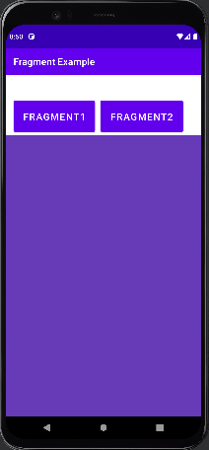
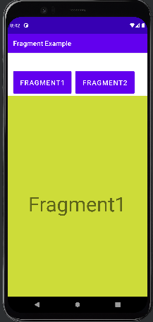
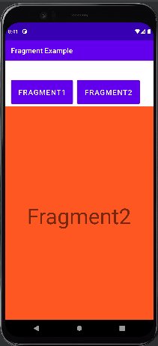
Example
Let’s consider an easier app that display different content on the same Activity when a button is clicked.

Slide 58
Implementation
public class Fragment1 extends Fragment { @Override public View onCreateView(LayoutInflater inflater, ViewGroup container,Bundle savedInstanceState) { // Inflate the layout for this fragment return inflater.inflate(R.layout.fragment_1, container, false); }
}
public class Fragment2 extends Fragment { @Override public View onCreateView(LayoutInflater inflater, ViewGroup container,Bundle savedInstanceState) {
// Inflate the layout for this fragment return inflater.inflate(R.layout.fragment_2, container, false); } }

Slide 59
Implementation
public class FragmentActivity extends AppCompatActivity { @Override protected void onCreate(Bundle savedInstanceState) { super.onCreate(savedInstanceState); setContentView(R.layout.activity_fragment); Fragment1 f1=new Fragment1(); Fragment2 f2=new Fragment2(); Button bt1=findViewById(R.id.btnFragment1); Button bt2=findViewById(R.id.btnFragment2); bt1.setOnClickListener(new View.OnClickListener() { @Override public void onClick(View view) { getSupportFragmentManager().beginTransaction().replace(R.id.flFragment,f1).commit(); } }); bt2.setOnClickListener(new View.OnClickListener() { @Override public void onClick(View view) { getSupportFragmentManager().beginTransaction().replace(R.id.flFragment,f2).commit(); }
);}
}

Slide 60
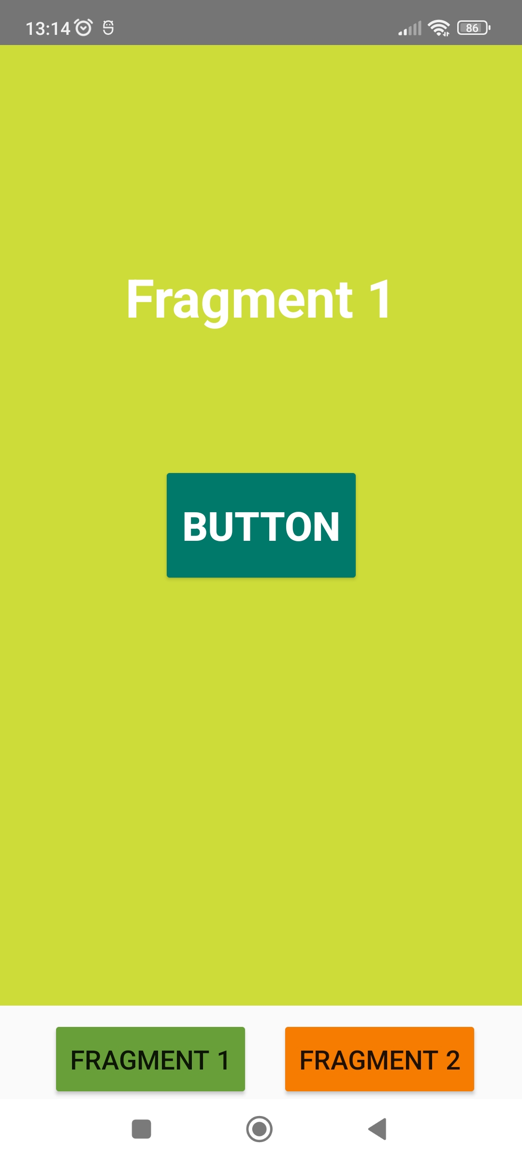
OnViewCreated
Fragment often contains elements such as buttons, editText etc.. how do we access them and get a reference?
Called immediately after onCreateView has returned, but before any saved state has been restored into the view. This gives subclasses a chance to initialize themselves once they know their view hierarchy has been completely created. The fragment's view hierarchy is not however attached to its parent at this point.
Parameters:
View view: The View returned by onCreateView()
Bundle savedInstanceState: If non-null, this fragment is being re-constructed from a previous saved state as given here.
public class Fragment1 extends Fragment { Button button; @Override public View onCreateView(LayoutInflater inflater, ViewGroup container, Bundle savedInstanceState) { // Inflate the layout for this fragment return inflater.inflate(R.layout.fragment_1, container, false); } @Override public void onViewCreated(@NonNull View view, @Nullable Bundle savedInstanceState) { super.onViewCreated(view, savedInstanceState); button=view.findViewById(R.id.fragment1_button); button.setOnClickListener(v -> Log.d("click","button inside Fragment1 was clicked")); } }
?

Slide 61
Curiosity
All fragments must have a public no-argument constructor. This is because Android uses it to reinstantiate the fragment when needed, and if it’s not there, you’ll get a runtime exception.
In practice, you only need to add one to your fragment code if you include another constructor with one or more arguments. This is because if a Java class contains no constructors, the Java compiler automatically adds a public noargument constructor for you

